Slide 1
MINING NETFLOW RECORDS FOR HOST BEHAVIORS
Teja Kommineni
Robert Ricci, Kobus van der Merwe and Suresh Venkatasubramanian

Slide 2
Thesis Statement
By combining clustering and other data mining techniques we can produce a view of host behaviors that helps network administrators
to understand behavior of the networks.
This system complements existing network analysis tools to ease network management.
Notes:
Read it and pause for a moment.

Slide 3
Thesis Statement Explained
Hosts
Behaviors (Packets, Bytes, Destinations, Protocols over a time period)
Network Management
Data Mining
Notes:
2) Behavior of a host is an aggregate of the amount of traffic that it sends both in terms of packets and
bytes, the set of destinations it tries to connect to , the set of protocols it uses over some time period.
So we want to find these host behaviors to ease network management.
3) Security, Capacity Planning, Congestion Handling, Quality Of Service, Threat Analysis, IDS, Traffic Classification.
4) There is lot of data to look into.. DM instead of ML is .. you want to find behaviors/patterns a human may have not known to look in first place.
Overall we want to find the behaviors of hosts group those behaving similarly so that they help in

Slide 4
Techniques used by admins
Aggregation by Ports, Protocols, Applications [SolarWinds]
Deep Packet Inspection
Rule Based Systems (IDS)
Notes:
1) In order to know the top used applications, who are contributing to major traffic, to understand the bandwidth requirements and to address congestion.
2) Inspects the actual payload of the packet. It is a fine grain version of above point. What are the sites or urls.
3) Limiting the number of attempts to login into a system, placing rules on how many requests a host can make in given time to avoid DDOS attacks.
We have built a tool that complements these existing techniques. Let us look into it in detail.

Slide 5
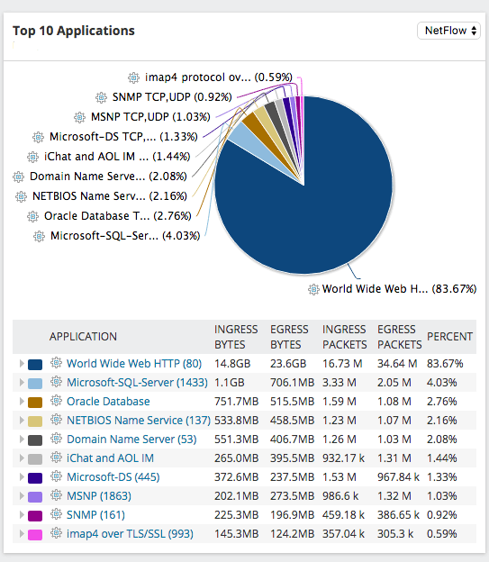
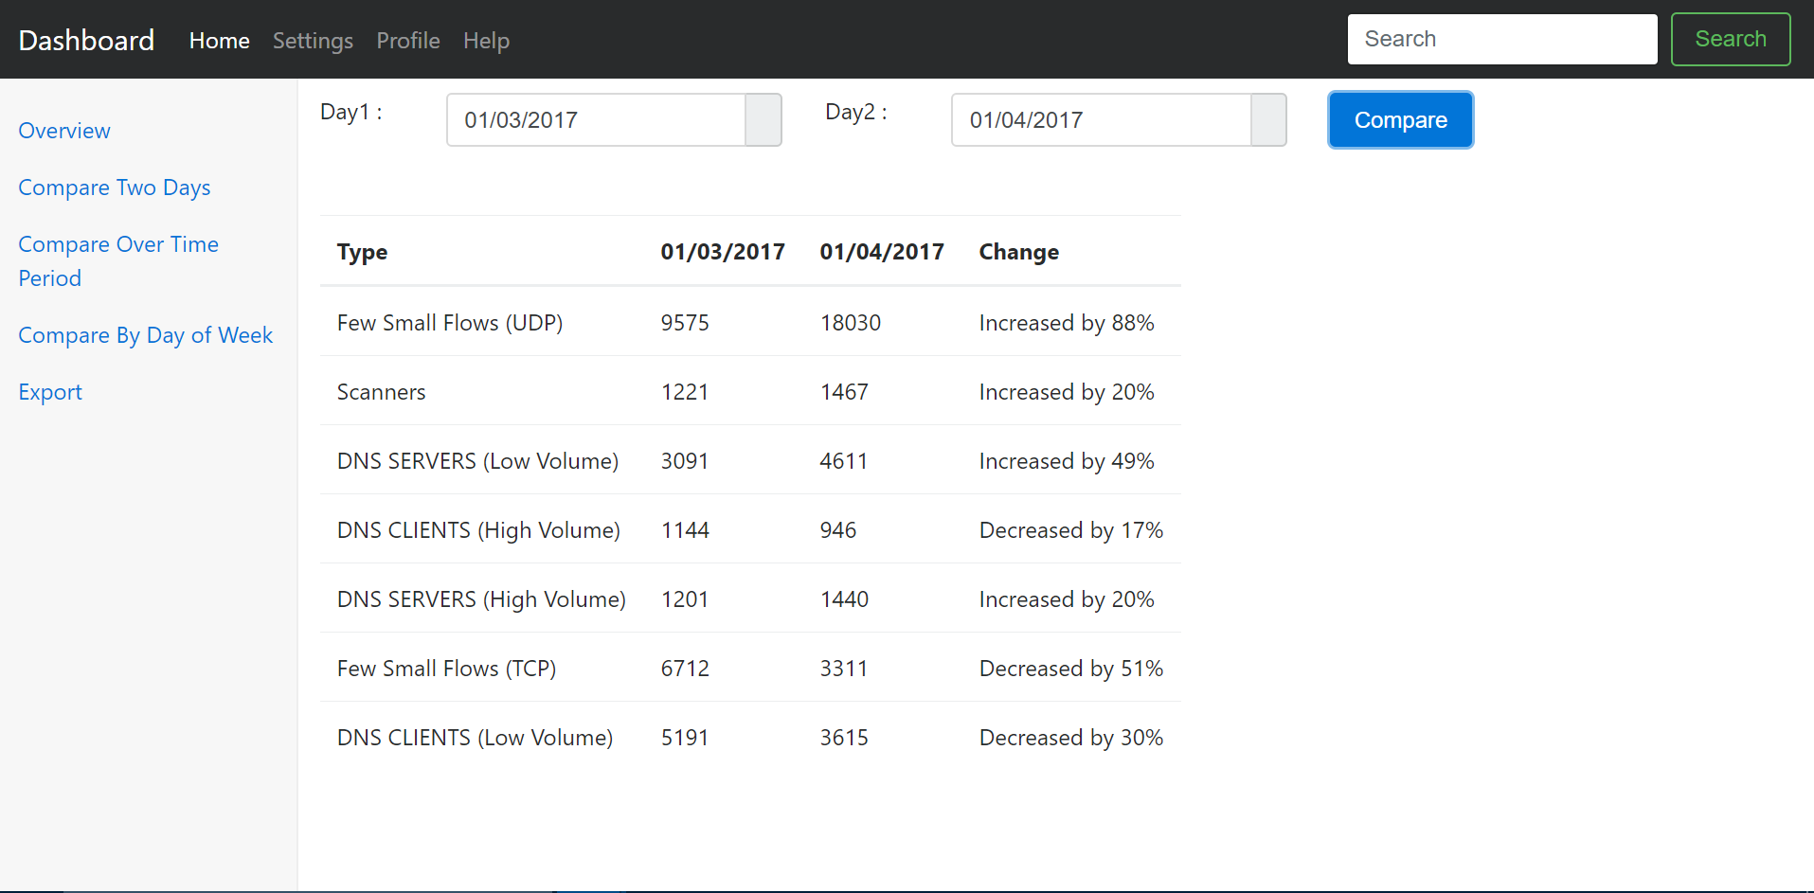
Complementary Tool
Solar Winds
Our Tool
It is a complementary tool.
Aggregate based on host behaviors.
Detects services run on same ports.
Notes:
Wide range of behaviors
How are these two similar? - They both use same data.
How are they different? – They are 2 different views of same data , while one aggregates based on ports other does it based on host behaviors. We induce domain knowledge to label these behaviors.
Why do we need a different tool? , similar ports for different services, thus making it tough to distinguish based on just a single feature.
Are we the first guys using ML, DM on network data.

Slide 6
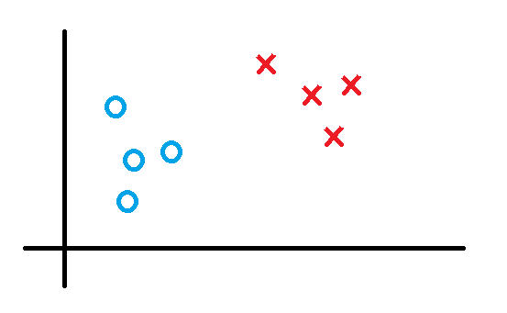
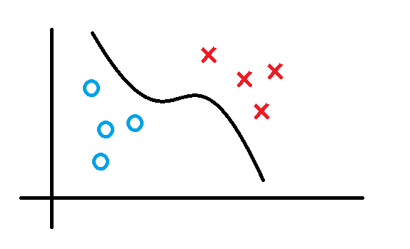
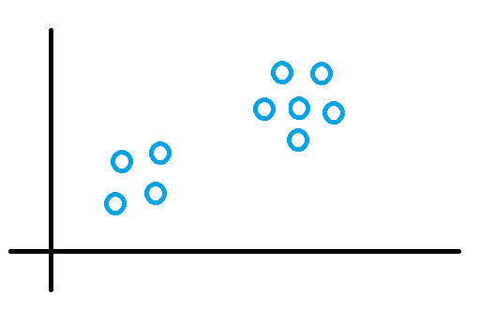
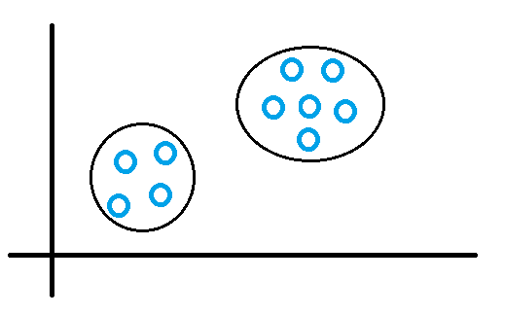
Related Work
Supervised vs Unsupervised Learning
Machine Learning for Traffic Classification [Andrew and Denis], [2012] [ACM]
Unsupervised approach for Traffic Classification [Jeffrey and Mahanti] [ACM] [2011]
X2
X2
X2
X2
X1
X1
X1
X1
Notes:
Before, talking about related work lets look at supervised and unsupervised learning. These two differ based on the data in hand and training the models.
Using this supervised technique mentioned now, people tried to classify network traffic into known classes. How our work is different from others?
Till now we have seen techniques used by the admins, the tool we ought to build and related work in this area. Now let us see how did we approach this problem. Just to reiterate the problem that we want to solve here is to determine the host behaviors and group those behaving similarly. We have built a system to solve this. In the next slide we will see the design of this system one component at a time.

Slide 7
Design
GUI
Feature Engineering
Pattern Detector
Anomaly Detectors
Host-Based Split
Capacity
Planning
export
Routers
Tools used
Implemented
export
Applications
NetFlow Collector
Notes:
explain why each component on first slide only. flow to hosts so we need to do host based split.
This is the structure for rest of my talk.

Slide 8
NetFlow Collector
Feature Engineering
GUI
Pattern Detector
Anomaly Detectors
Host-Based Split
Routers
Capacity
Planning
NetFlow Collector
Tools used
Implemented
Applications
Input Data (Flows)
What is NetFlow?
Why NetFlow Collector?
Notes:
Since, collecting all the packets is tough and infeasible
All packets with the same source/destination IP address, source/destination ports, protocol interface are grouped into a flow. In short flow is an instance of communication between two hosts.
For each flow we capture other details such as duration, flags, packets, bytes and others ...
For example, A tcp connection to get a web page is a flow.
So, what we are see in this step is detail of every connection made in the network.

Slide 9
Feature Engineering
Feature Engineering
GUI
Pattern Detector
Anomaly Detectors
Host-Based Split
Routers
Capacity
Planning
NetFlow Collector
Tools used
Implemented
Applications
Notes:
The table that we are seeing on screen is a n example of raw data obtained from previous step. This data cannot be used directly in ML. We need to clean this data and select those columns that better represent the problem we ought to solve. These selected columns are called features and this process of cleaning and selecting features is called Feature Engineering. Even simpler ML algos work well if we select good features.

Slide 10
Missing Data
Feature Engineering
GUI
Pattern Detector
Anomaly Detectors
Host-Based Split
Routers
Capacity
Planning
NetFlow Collector
Tools used
Implemented
Applications
Notes:
Missing data is a common issue that DM experiments should deal with as they could lead to exceptions and wrong observations.

Slide 11
Feature Engineering
GUI
Categorical Data
Pattern Detector
Anomaly Detectors
Host-Based Split
Routers
Capacity
Planning
NetFlow Collector
Tools used
Implemented
Applications

Slide 12
GUI
Host Based Split
Feature Engineering
Pattern Detector
Anomaly Detectors
Host-Based Split
Routers
Capacity
Planning
NetFlow Collector
Tools used
Implemented
Applications
feature
Host behavior
Feature Scaling
Notes:
Till now we have seen the details of every connection made by each host, but we want model host behaviors and hence we are aggregate the following details per host. explain them and each column is called feature and each row/ record defines the behavior of that particular host for a given day.
One aspect of this data that I have to mention here is the skewness of the data as shown in next page.

Slide 13
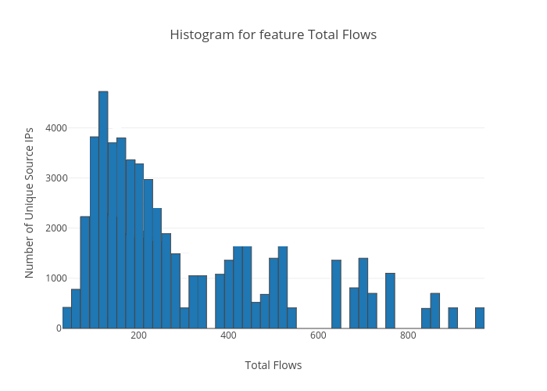
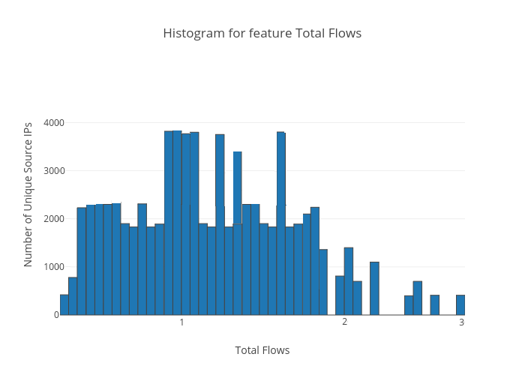
Normalization
Feature Engineering
GUI
Pattern Detector
Anomaly Detectors
Host-Based Split
Capacity
Planning
NetFlow Collector
Tools used
Implemented
Applications
Total Packets
Total Packets
Notes:
Each feature is highly skewed towards the left and the reason for this is most hosts.
By the end of this step we have modeled host behaviors using the NetFlow data and are set to group all the hosts that behave similarly.

Slide 14
GUI
Pattern Detector
Feature Engineering
Pattern Detector
Anomaly Detectors
Host-Based Split
Capacity
Planning
NetFlow Collector
Tools used
Implemented
Applications
Why Unsupervised Learning?
Why Clustering ?
Why K-Means ?
Over-Fitting
Scalable
Notes:
1) By now, one might have clearly seen that our data doesn’t have any labels. So, as we talked in the related section this falls under Unsupervised Learning. Also, we want to group all those hosts that behave similarly. Clustering is the task that groups objects that are similar to each other.
2) We have chosen K-Means clustering to solve this problem and our reason is 3-fold. Over-fitting, Scalable, our practical exp with other algos. Let us see what K-Means algorithms is all about.

Slide 15
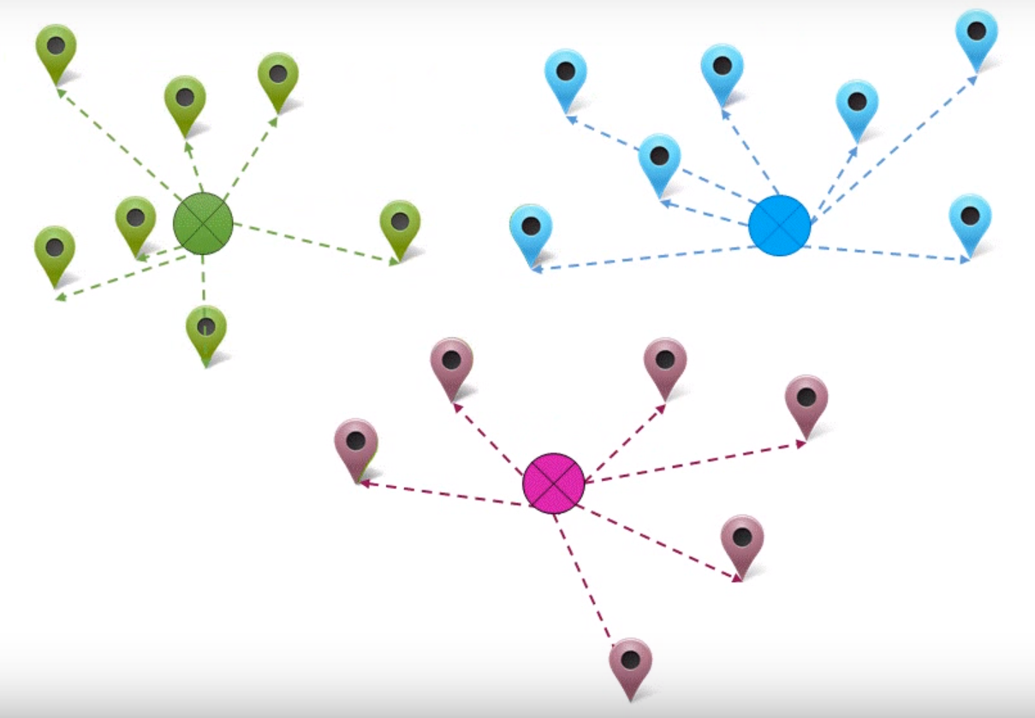
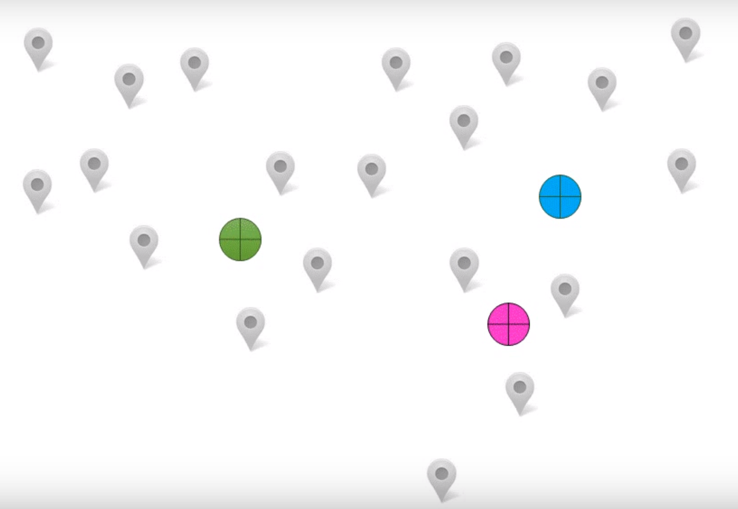
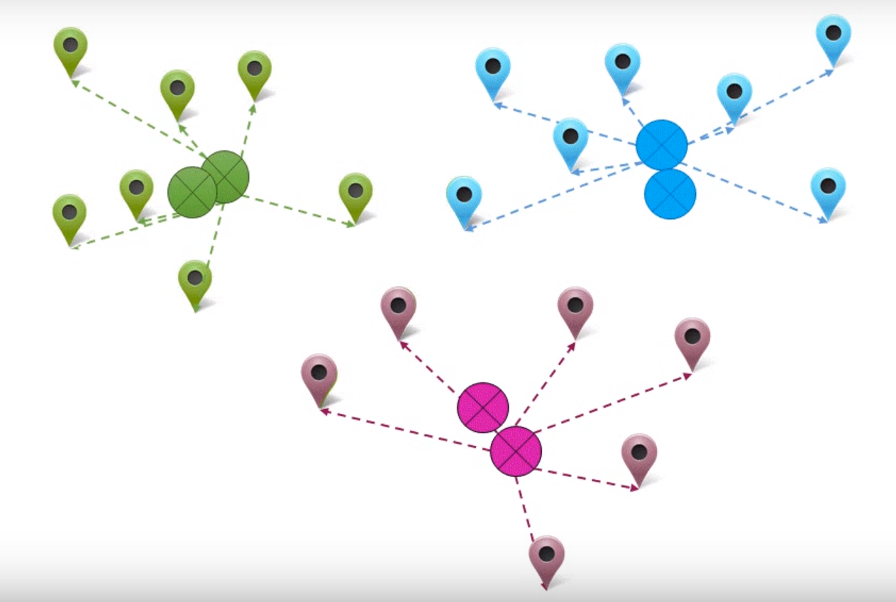
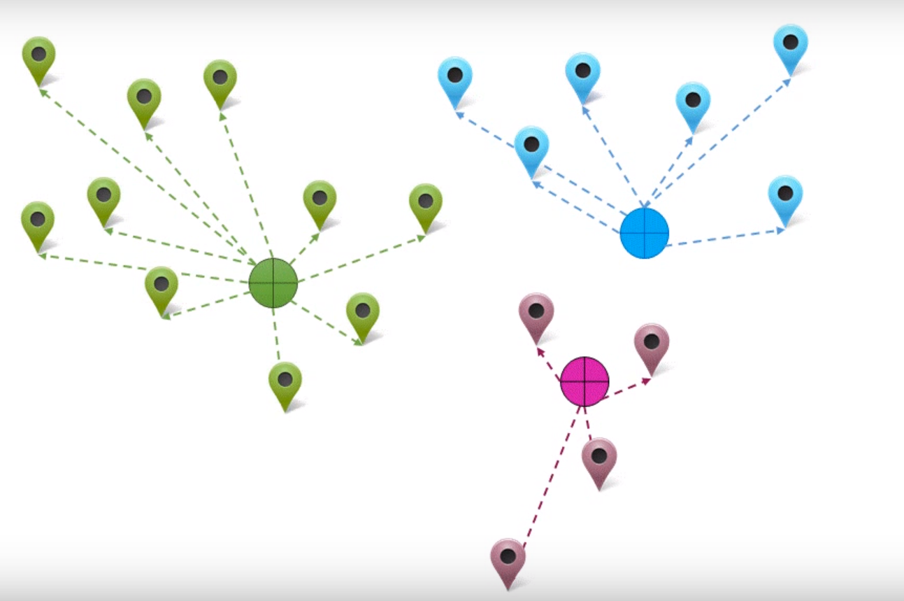

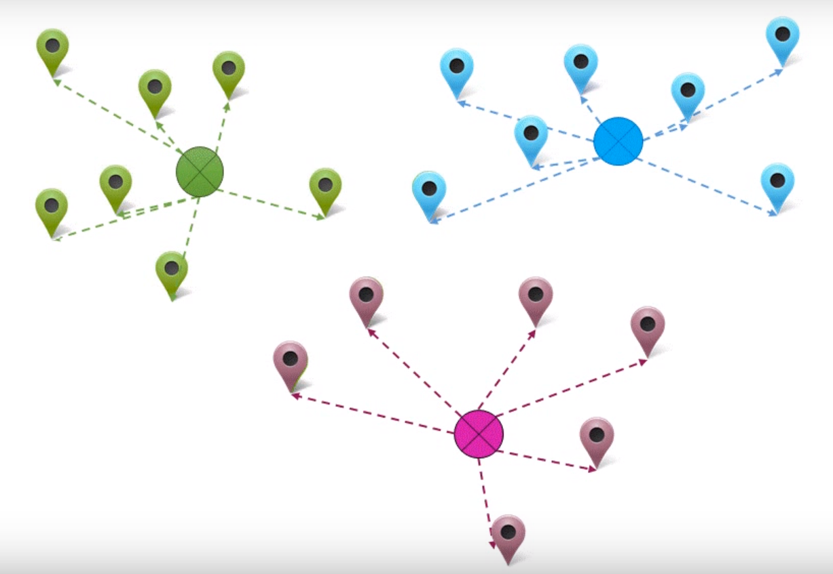
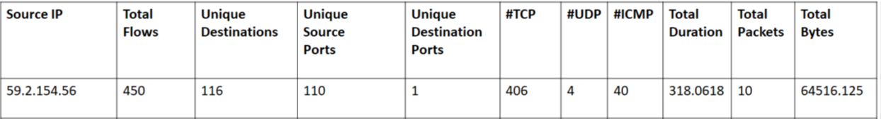
K-Means
Feature Engineering
GUI
Pattern Detector
Anomaly Detectors
Host-Based Split
Capacity
Planning
NetFlow Collector
Tools used
Implemented
Applications
Notes:
1) Given a set of data points K-Means algorithms groups these points in to K clusters and it uses distance as a metric to do this.
2) Here each data point corresponds to a host behavior.
3) Initially we select cluster centers randomly. In this case 3.
4) We measure the distance between each point and all the cluster centers and we assign this point to the closest cluster center.
5) Now for each cluster we recalculate the cluster center which is the mid point of all the data points in that cluster.
6) And then we repeat this process again till the cluster centers are stable.
That is all about K-Means clustering.

Slide 16
GUI
How to choose K ?
Feature Engineering
Pattern Detector
Anomaly Detectors
Host-Based Split
Capacity
Planning
NetFlow Collector
Tools used
Implemented
Applications
Elbow Method
Silhouette
Compactness
K
K
Notes:
As we saw just now we need to specify an initial K value for K-Means. We can’t choose a random K value as higher value can give us repetitive behaviors and small K value doesn’t give any useful info.
Also each network has hosts exhibiting different set of behaviors which means a different k value is needed for different networks and hence we need a method to determine K.
We used the elbow technique to determine K value and confirmed the same with silhouette approach. In elbow method for each value of K we calculate the compactness of clusters and draw a graph. Initially the compactness increases and after a point the rate of increase drops and we see a curve in the graph also called as elbow. The K value at this point used for K-Means algo.
In the Silhouette approach we calculate average Silhouette index for all the points for each K. Silhouette index measures how perfectly does a point belong to its cluster. The K value corresponding to max silhouette index is the value we use for K-Means.
In our case we found the K value as 7. So, we have found seven unique behaviors hosts are exhibiting in our system. Now, let us see what we have done till now in form of a process diagram.

Slide 17
Process Diagram..
Reference Day
Interactive Traffic 1
K – Means (K = 7)
Interactive Traffic 2
Clients 1
Clients 2
Servers 1
Servers 2
Scanners
Notes:
What are these ? These are data points and each data point corresponds to a host and its behavior.
So to automate this process we chose a reference day and apply domain knowledge to label the clusters

Slide 18
Process Diagram..
Reference Day
Interactive Traffic 1
K – Means (K = 7)
Interactive Traffic 2
Clients 1
Clients 2
Servers 1
Servers 2
Scanners
Notes:
What are these ? These are data points and each data point corresponds to a host and its behavior.
There are two points that I want to mention here. 1) This one to one mapping works because the number of behaviors that our hosts are exhibiting is constant over time. 2) If network administrator observes there is a change in the way the network is being used. He can chose a new reference day that captures these changes perform our process and label the clusters and use this new reference day going forward. 3) For time purposes I will not describe the way we have done one-one-mapping, We have used Hungarian algorithm an implementation of Earth Movers Distance and further details can be found in thesis.

Slide 19
Data set
Data Source | Emulab Routers
Time Period | Eight Months
Average number of Flows per day | 40 Million
Average number of Hosts per day | 30000
Notes:
Let us first look at the data-set we are working with. And, the first results that I would like to point is constant behaviors.

Slide 20
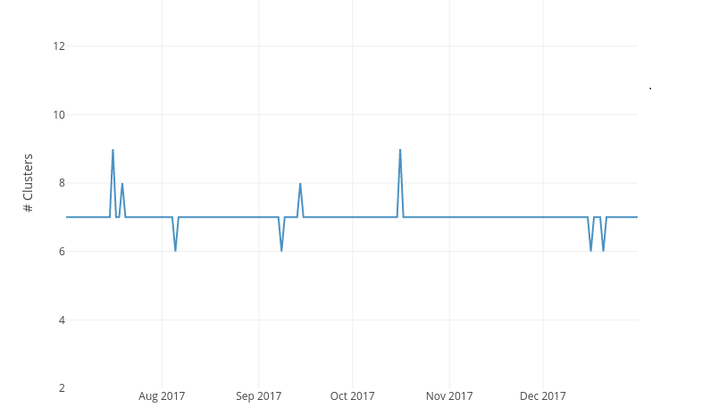
Constant Behaviors..

Slide 21
Results
Cluster Label | Cluster Definition
Interactive Traffic 1 (T1) | One-one connections, http/https, ssh and peer to peer traffic (long living flows with large average packet sizes)
Interactive Traffic 2 (T2) | large number of flows which are short-lived and an average packet size less than T1
Clients 1 (C1) | clients making connections with different servers. Hosts with request for web pages and outbound mail traffic.
Clients 2 (C2) | dominated by DNS traffic which is in accordance with the heavy DNS requests that the hosts residing in the emulab network make.
Servers 1 (S1) | majority of hosts which are within emulab network and are acting as servers accepting SSH requests.
Servers 2 (S2) | hosts that are both within and outside emulab network which are acting as servers for different sets of traffic such as SSH, Web and DNS.
Scanners (A) | hosts that exhibit anomalous behavior trying to scan different access points to enter into the system.
Notes:
1) We found two clusters in which hosts make one-one connections and exchange http, ssh and peer to peer traffic. The two clusters differ in the average packet size. While, T1 has hosts exchanging larger packets. T2 has hosts exchanging smaller packets.
2) We found two clusters in which hosts are trying to make connections with different servers. We named these as clients C1 and C2. C1 contains hosts trying to connect to web and mail servers where as C2 consists of clients making DNS requests.
3) We found two clusters where hosts are behaving as servers and accepting connections on different ports. While S1 contains servers that are within the network. S2 contains a mix of both internal and external hosts serving SSH, Web and DNS requests.
4)

Slide 22
Cross-Validation
Port based host classification
Web (80), DNS (53), SSH(22), TELNET(23), SMTP(25), FTP(21), MIX, SCAN.
What are interesting results?
Notes:
1) We wanted to verify if these behaviors that we found are accurate to how network hosts are behaving in our system. We performed cross validation to verify this.
2) Let me explain the set up before showing the results. We performed host classification based on ports. We observe if more than 50% of the time a host is using particular port in exchanging traffic and if so it is classified under that port. If we don’t find any majority port for a host we put it under MIX traffic.
3) Now, in each cluster we see how the hosts are distributed based on this port based classification.
4) What are the interesting results: Clusters shouldn’t be dominated by single port. Because, we want our process to take into consideration all the features that we passed not just the port. Is it finding something useful than the just port that one

Slide 23
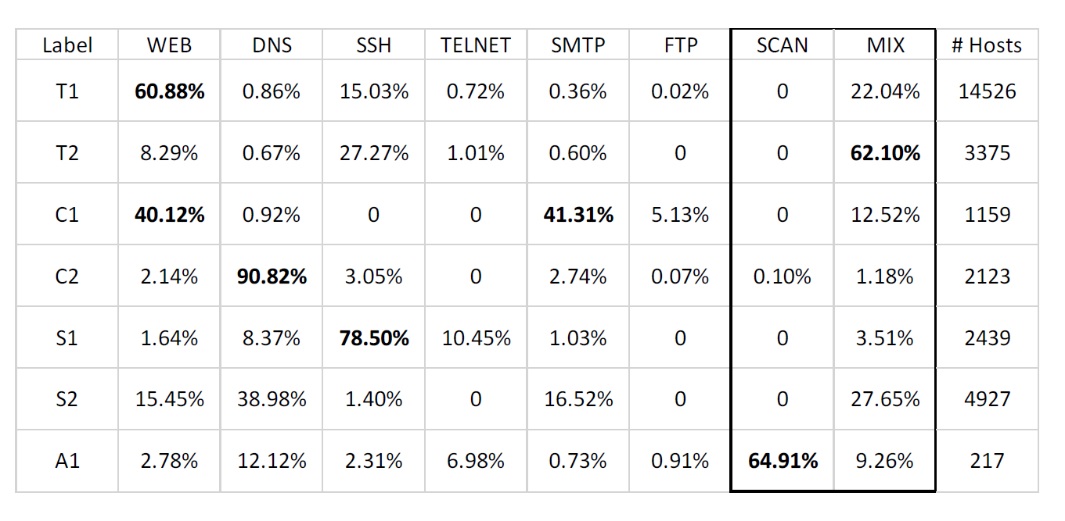
Cross-Validation
Notes:
Let me read out this table. The first column indicates the clusters we obtained and the first row indicates the different classes based on ports. For example, the top most cell has a value of 60.88% indicates that within cluster T1 there are 60% of hosts which majorly use port 80 for communication.
We can see cluster T1 also comprises hosts using other ports such as DNS, SSH, etc.. So, when we sum up the row it corresponds to 100%.
Look at each row, though the hosts are using various ports involved they all behave similarly.
Also, I have mentioned that our tool is complementary to existing port based approaches, So If the clusters we are learning correspond to what we get from a port based tool then we didn’t learn anything new. But, that is not the case here. For example, all the web traffic would have been grouped together in a port based approach but in our case it is split across.
They also confirm the labels that we gave to these clusters.

Slide 24
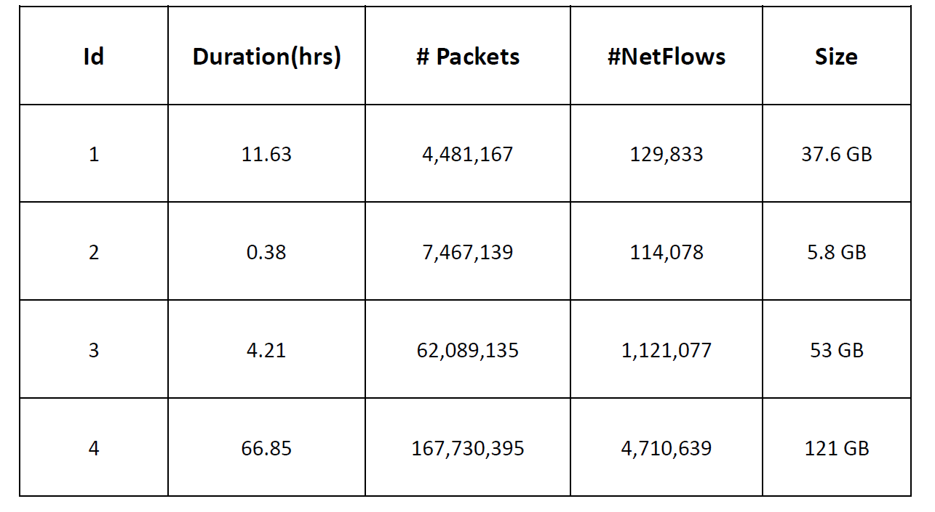
Labeled Data
Center for Applied Internet Data Analysis
Give an intuition of what is good and bad result.
Notes:
Till now we have done a qualitative measure of our system by cross-validating with port based approach. Now we want to quantify our system’s performance, and hence we use labeled data to do it. We obtained this data from CAIDA. The features of this data set are it is synthetic data, they mixed real data with synthetic data. This table shows us four of these captures. One other important feature of this data set is each host has been labeled. That is each host behavior is labeled. So, now we can also measure how accurate our system is in measuring behaviors.
Experiment Set up:
Instead of manually inspecting and labeling the clusters. We retain the majority label of the hosts in that cluster as the cluster label.

Slide 25
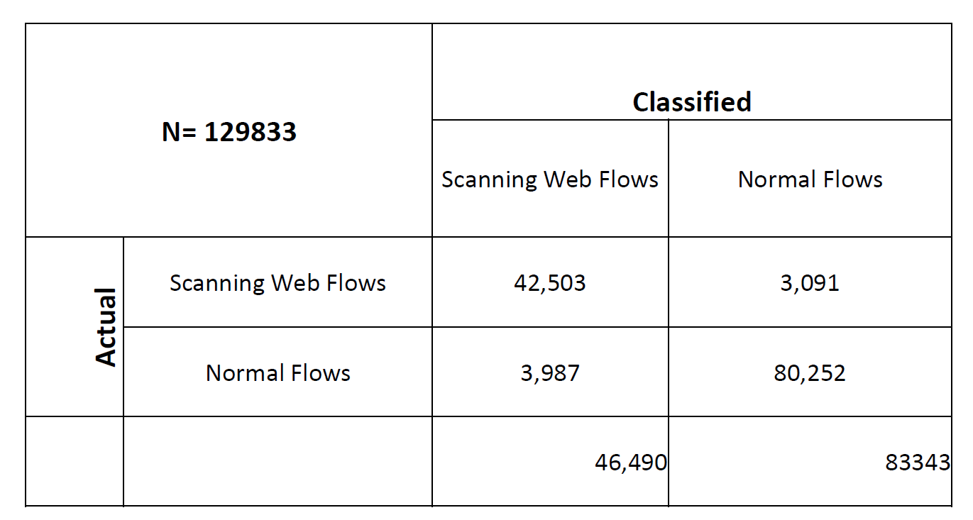
Results
91.4% accurate in finding scanners.
96.2% accurate in finding normal hosts.
Notes:
This is a confusion matrix, that gives results of the experiment.
Here we used data from first scenario listed previously. The hosts in this scenario exhibit two different behaviors. Normal Flows, which means one-to-one connections and interactive traffic. Scanning Web flows, hosts which are scanning all the ports to sneak into the network. A confusion matrix has to be read like this: N indicates total number of flows in the data set. Classified indicates how our system classified these flows and actual indicates what actually these are labeled as.
This is interesting result because , when we passed a new set of unobserved data through our system we got results which are around 90% accurate to the labeled information.

Slide 26
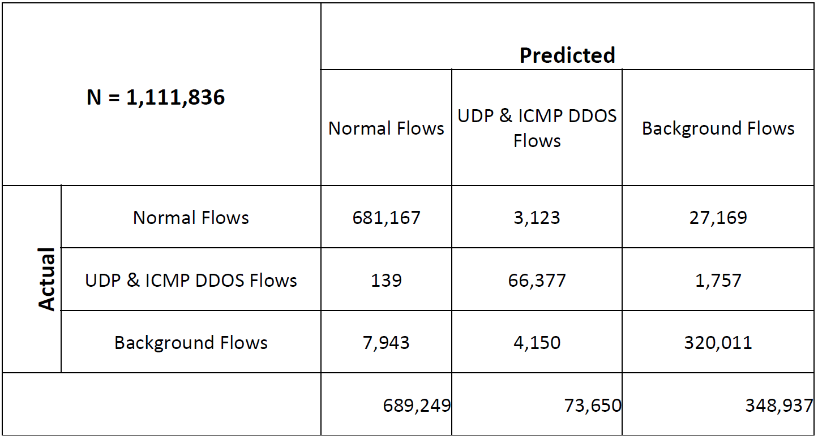
Results
91.1% accurate in finding background hosts.
98.8% accurate in finding normal hosts.
90.23% accurate in finding UDP & ICMP DDOS hosts.

Slide 27
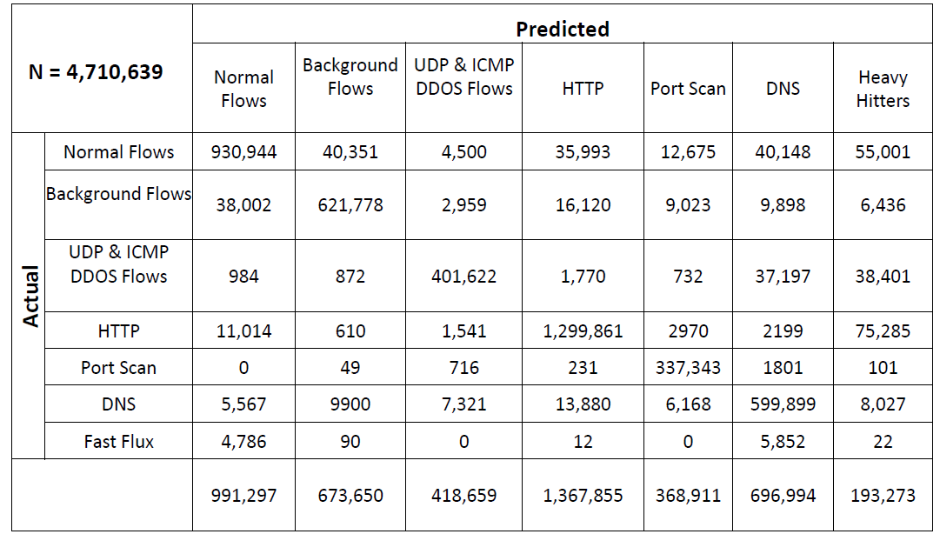
Results

Slide 28
Applications
Feature Engineering
GUI
Pattern Detector
Anomaly Detectors
Host-Based Split
Capacity
Planning
NetFlow Collector
Tools used
Implemented
Applications
Notes:
We also gave a tool for network administrator to visualize our results. This is how the web interface looks like, on the left nav bar we have various options to explore the results. For example, if we want to compare the behaviors on two different days.

Slide 29
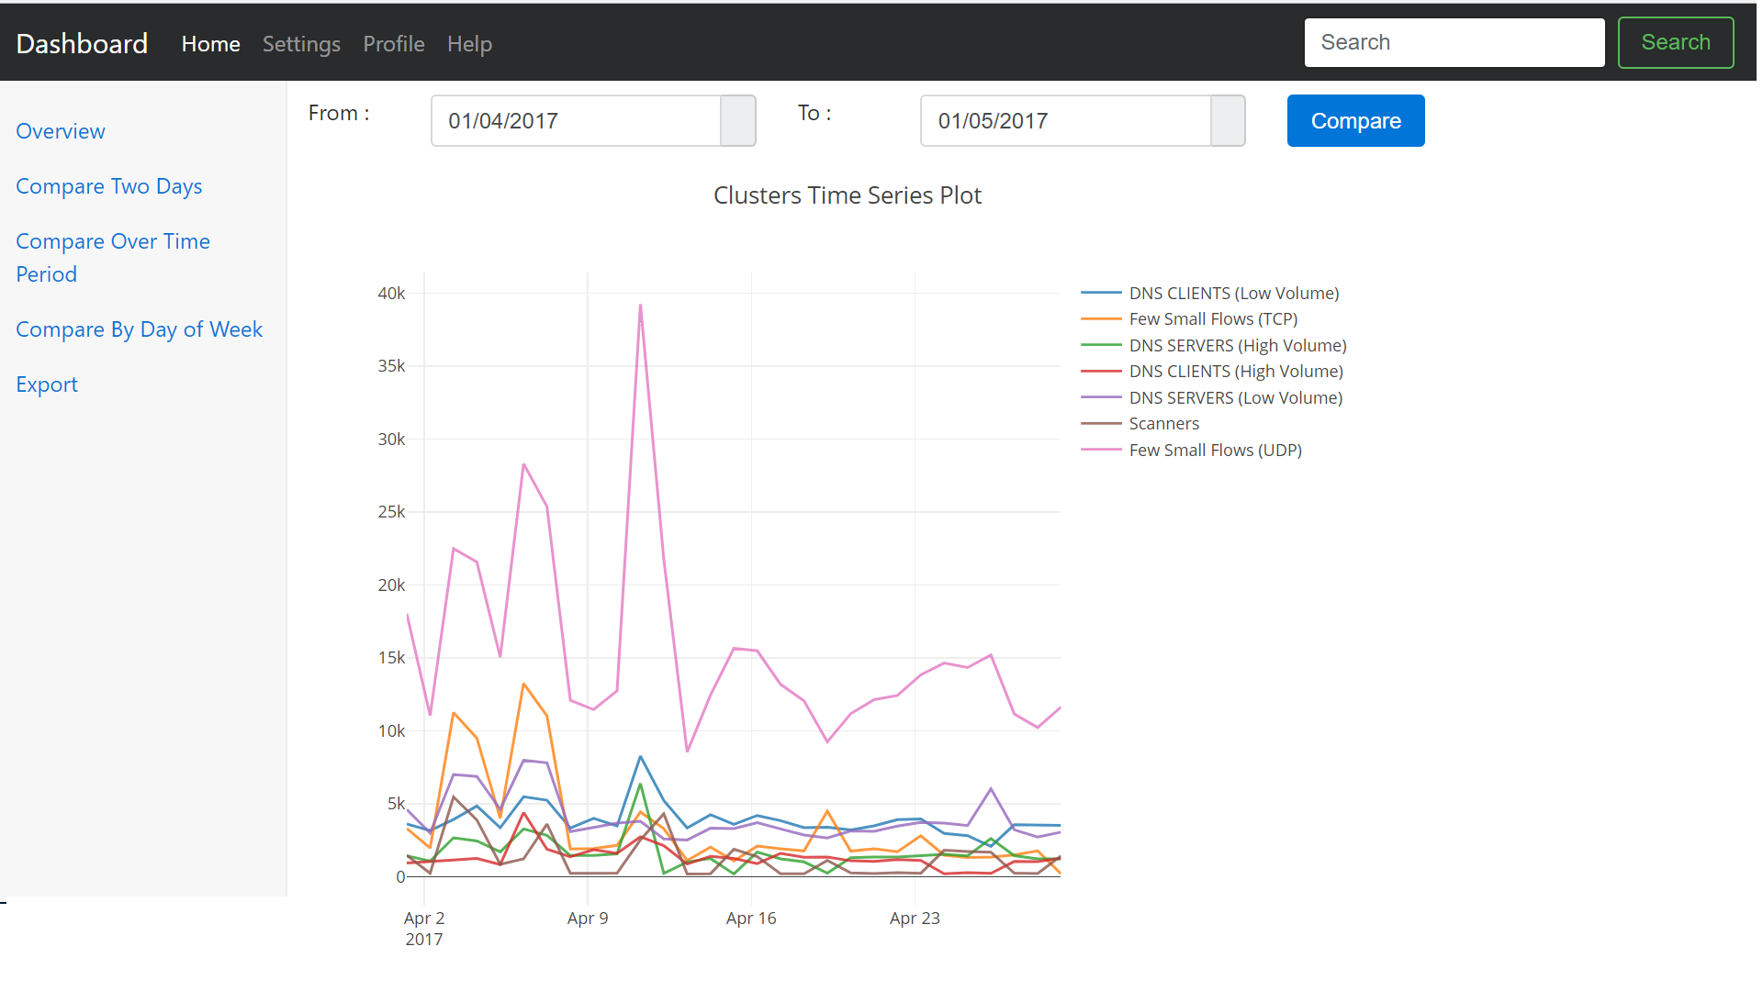
GUI
Applications
Feature Engineering
Pattern Detector
Anomaly Detectors
Host-Based Split
Capacity
Planning
NetFlow Collector
Tools used
Implemented
Applications
Notes:
How can people build up on our system or what future directions they can take

Slide 30
Future Work
Applications
Temporal Clustering
Streaming Algorithms
Notes:
1) Using results from our system we can build applications that benefit network administrator. For example, by observing the Anomalous cluster formed people can build Anomaly detectors or Dynamic Firewall Rule generators.
2) Earlier we have mentioned that the network administrator can change the reference day when he observes there is a change in the way network is being used. We can formalize this process by using Temporal Clustering. Using temporal clustering we can measure how far the clusters are displaced over any two days and can configure when a admin has to be notified.
3) We can also explore streaming algorithms that leave lesser memory foot print while capturing various characteristics about data. They also help us in settings were we don’t have any provision to store the data but we can only see once.

Slide 31
Conclusion
“By combining clustering we can produce a view of host behaviors that helps network administrators
to understand behavior of the networks.”
“our contribution shows that the
8D feature vector, that captures the behavior of a host, combined with K-means clustering
technique gives us classification of host behaviors in an unsupervised manner.”
Notes:
To conclude, using the NetFlow data collected at Emulab routers we were able to aggregate based on host, model their behaviors and group all those which are behaving similarly. We also performed validation to confirm these behaviors and extended our approach to unseen labeled data to quantitatively measure the significance of the system we built.

Slide 32
THANK YOU

